Slide 1
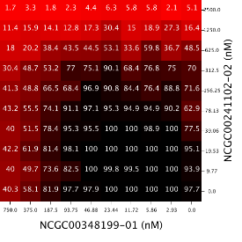
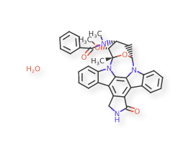
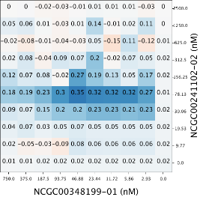
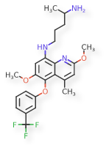
Similar Compounds Show Similar Activities- Is This True for Drug Combinations?
Intern: Sarita Lee
Mentors: Raj Guha & Lu Chen
Notes:
Introduce yourself- Sarita, UCLA, statistics (spatial statistics),
informatics, drug combinations (matrix @ NCATS)

Slide 2
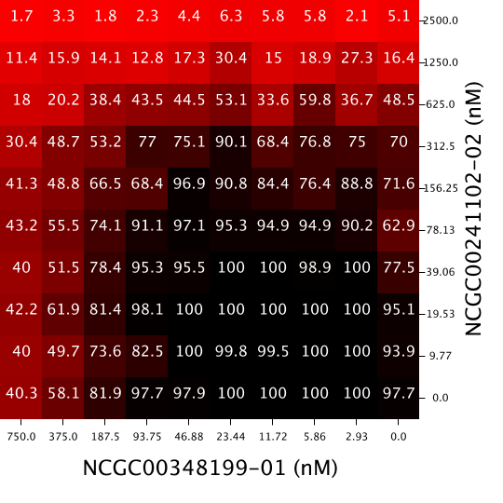
Introduction- Drug Combinations and Synergy
Response Matrix
Drug combinations are used to treat many medical conditions such as: HIV, malaria, and cancer
Sometimes the combined effect of drugs is different than their individual effects
When it is better: synergism
When it is the same: additive
When it is worse: antagonism
Drug Y
Drug X
Notes:
Several medical conditions such as HIV, malaria and cancer
outcome/response for patients is better when drugs are used together in treatment
Using drugs together is a drug combination
Synergy, etc.

Slide 3
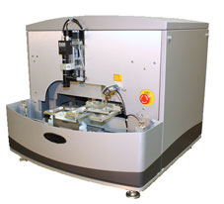
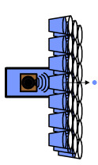
Introduction- Screening Drug Combinations
Run single agent dose responses
Traditionally, screening for drug combinations has been a slow process
Since NCATS has high throughput screening (HTS), data for thousands of drug combinations can be generated quickly
Presents opportunity to do large scale analysis
6x6 matrices for
potential synergies
Acoustic dispense,
15 min for 1260 wells, 14 min for 1200 wells
10x10 for confirmation + self-cross
Notes:
- However, finding these drug combinations is not a fast process
- Depends on observation by clinicians
- Want a dependable and robust process that is fast-
- If we’re able to quickly figure out what drug combination works for a specific disease, we can improve health in patients
- NCATS- high throughput screening- where the response to thousands of drug combinations can be measured
- My role: understand what that data means

Slide 4
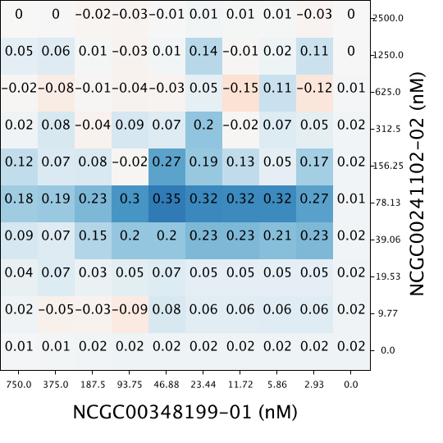
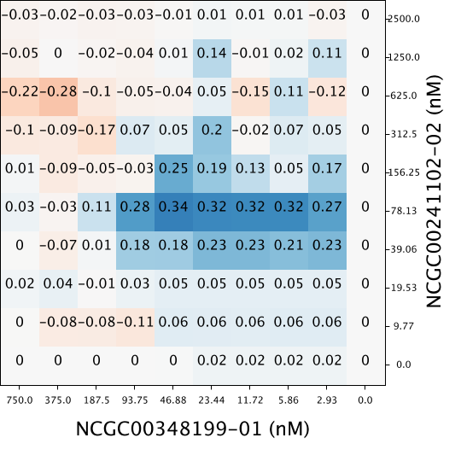
Introduction- Methods to Measure Synergy
Synergy is quantified with respect to a model of additivity
Three Models:
Highest Single Agent (HSA)
Bliss Independence Model
Loewe Additivity Model
Used Bliss Independence Model: convenient and more robust in high throughput setting
Response Matrix
Synergy Matrix-
HSA
Synergy Matrix-
Δ Bliss
Nikolaus J. Sucher (2014). Searching for synergy in silico, in vitro and in vivo. Synergy, 1(1), 30-43.
Notes:
Introduced concept of synergy- effect of drugs together is higher than what they would be alone
Different models of synergy, three in particular (can see slightly different synergy matrices based on which model is used)
Bliss- appropriate for how the data was collected

Slide 5
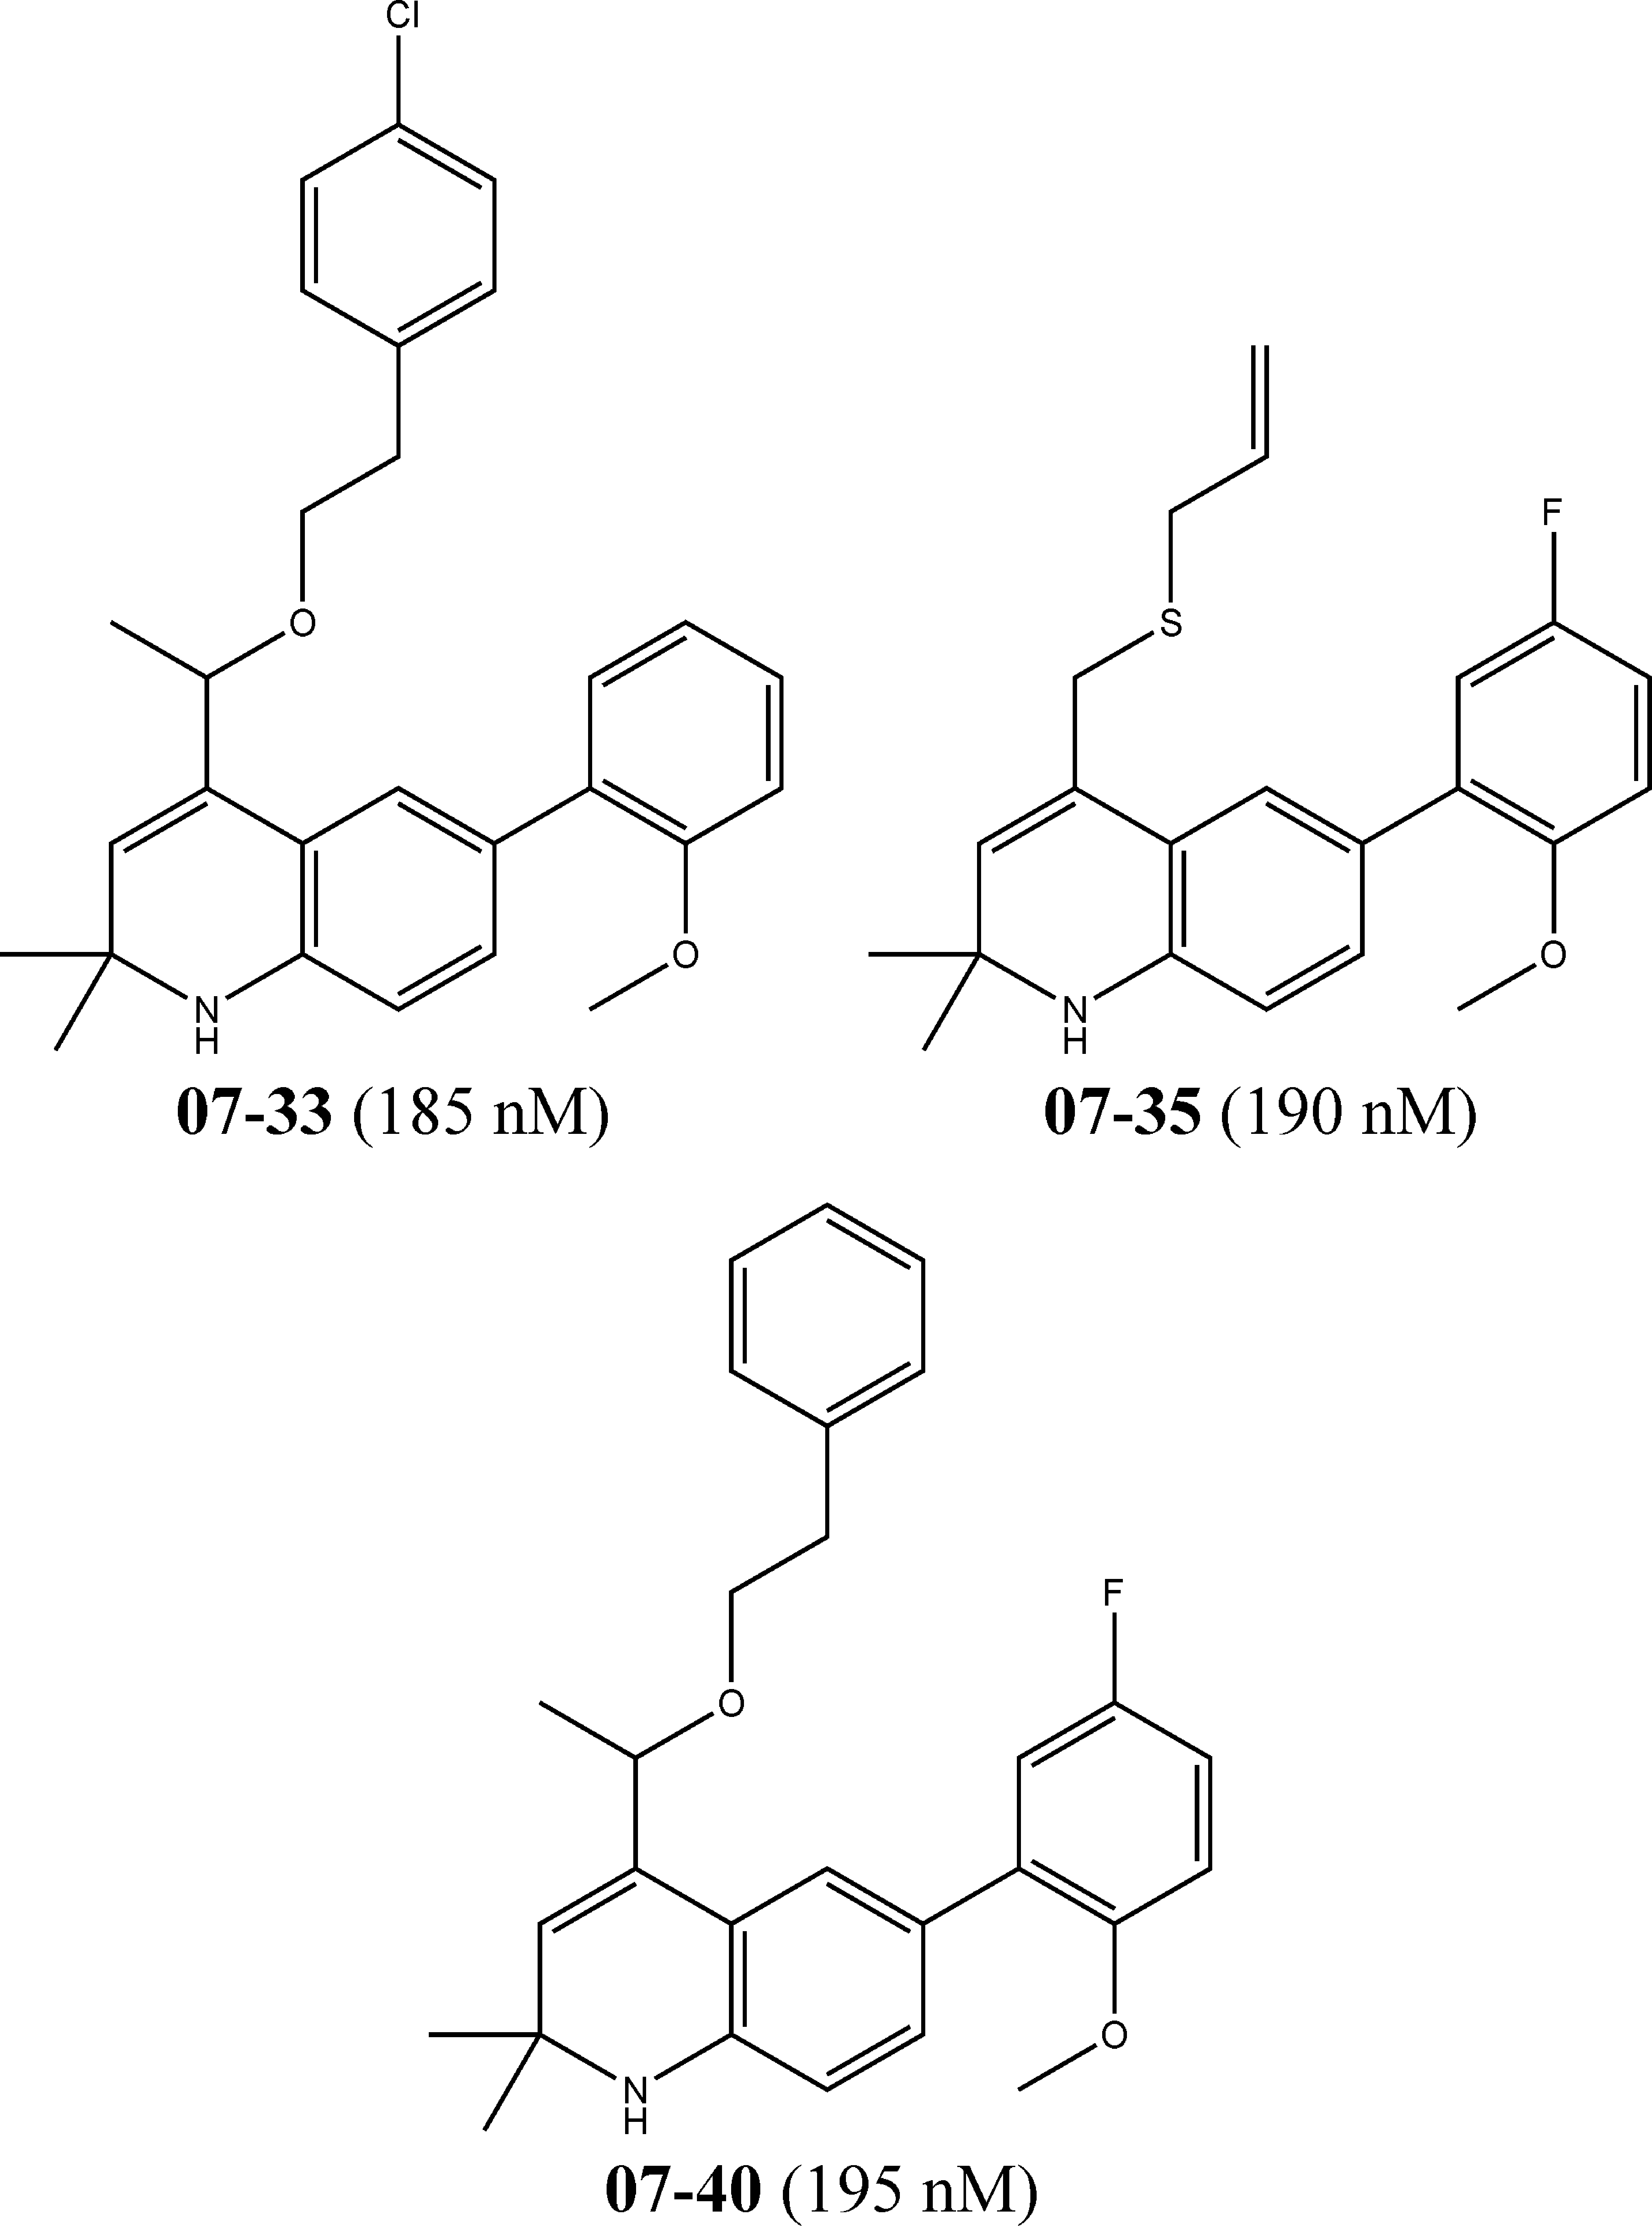
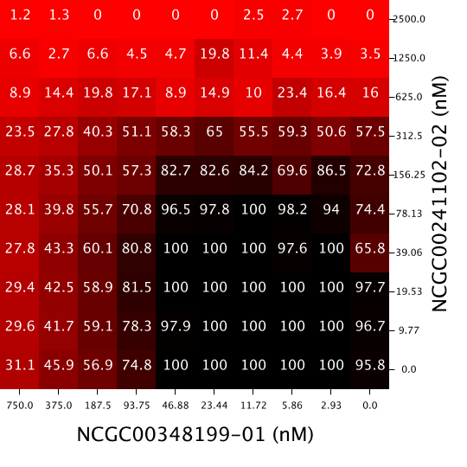
Introduction- Similarity Property Principle
Similar Compounds- tend to show similar activities
Dissimilar Compounds-
tend to show dissimilar activities
Similarity Property Principle: “Similar compounds have similar properties”
Will the similarity property principle hold for drug combinations?
Do similar drug combinations have similar properties?
Yvonne C. Martin, James L. Kofron, Linda M. Traphagen (2002). Do Structurally Similar Molecules Have Similar Biological Activity? Journal of Medicinal Chemistry, 45 (19), 4350-4358.
Rajarshi Guha, John H. Van Drie (2008). Structure-Activity Landscape Index: Identifying and Quantifying Activity Cliffs. Journal of Chemical Informatics and Modeling, 48(3), 646-658.
Notes:
The reason that we’re talking about synergy (a property of the drug combination)
Understood concept in cheminformatics (?) that similar compounds have similar properties (comparing one drug to one other drug)
What isn’t known- is if this (the SPP) is also true in drug combinations

Slide 6
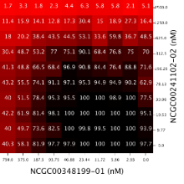
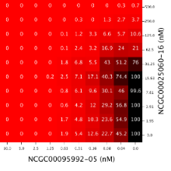
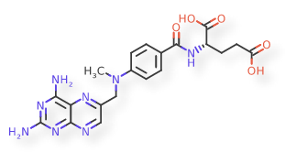
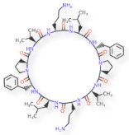
Overarching Questions
Question 1: What are metrics to quantify dissimilarity between two response matrices or synergy matrices?
Question 2: Does chemical structure correlate to combination response? Synergy? How?
Question 3: Does dose response correlate to combination response? Synergy? How?
Drug Combo A:
Response Matrix
Drug Combo B:
Response Matrix
Drug Combo A:
Compounds
Drug Combo B:
Compounds
Drug Combo A:
Dose Response
Drug Combo B:
Dose Response
Notes:
“Do similar drug combinations have similar properties?”
Raises questions within itself:
Similarity: How do we say how similar or dissimilar (not similar) two drug combinations are?
If chemical structure correlates with combination response and dose response correlates to combination response, might indicate SPP is true for drug combos

Slide 7
Overarching Questions
Question 1: What are metrics to quantify dissimilarity between two response matrices or synergy matrices?
Question 2: Does chemical structure correlate to combination response? Synergy? How?
Question 3: Does dose response correlate to combination response? Synergy? How?
Drug Combo A:
Response Matrix
Drug Combo B:
Response Matrix
Drug Combo A:
Compounds
Drug Combo B:
Compounds
Drug Combo A:
Dose Response
Drug Combo B:
Dose Response
Notes:
Come back to the other questions later
First aspect is saying how dissimilar two response matrices are

Slide 8
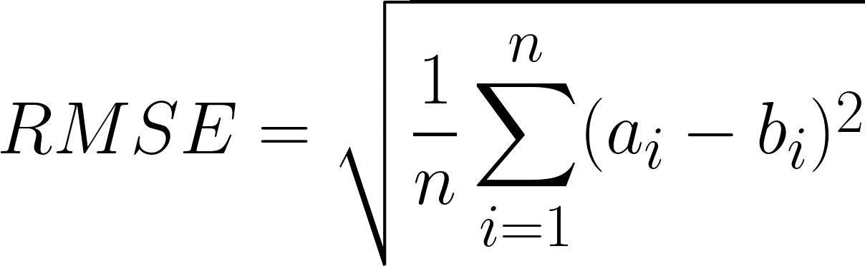
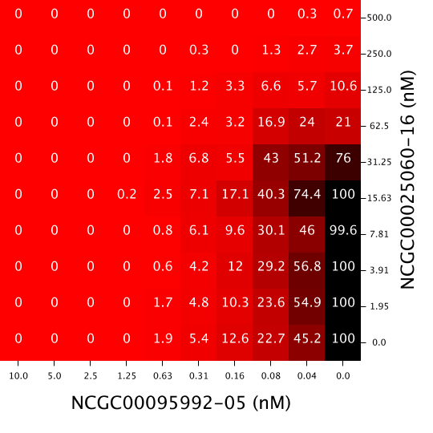
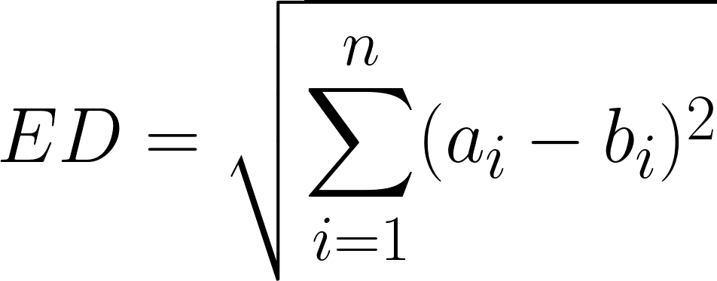
Question 1: Dissimilarity Metrics
Insensitive to Spatial Distribution
Sensitive to Spatial Distribution
1. Root Mean Standard Error (RMSE)
2. Euclidean Distance (ED)
3. Two- Sample Kolmogorov-Smirnov Test (KS Test)
4. Syrjala Test
Drug Combo A
Drug Combo B
Using these four metrics, dissimilarity was computed for all pairs of drug combinations
Stephen E. Syrjala, (1996). A Statistical Test for a Difference between the Spatial Distributions of Two Populations. Ecology, 77(1), 75-80.
Notes:
Insensitive to spatial distribution:
RMSE and ED- pairwise
KS test- bit more sophisticated because it’s a test - still doesn’t take into account how the entries are in relation to eachother in the grid (matrix)
Sensitive to Spatial:
Syrjala- does take into account the spatial (the patterns) (main one that will be used in the presentation)

Slide 9
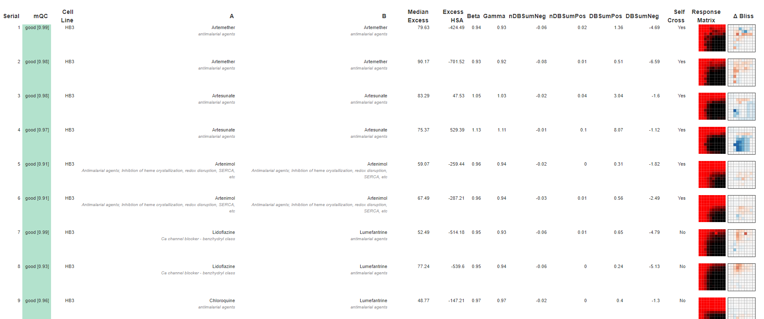
Question 1: Dissimilarity Metrics- Malaria AID 1764 (cell line HB3)
(First 9 drug combinations displayed; 480 total in the assay)
Notes:
As mentioned previously, Malaria is a disease for which drug combinations are used in treatment
Information about Malaria
Prevalence of Malaria
Treatment for Malaria
etc.

Slide 10
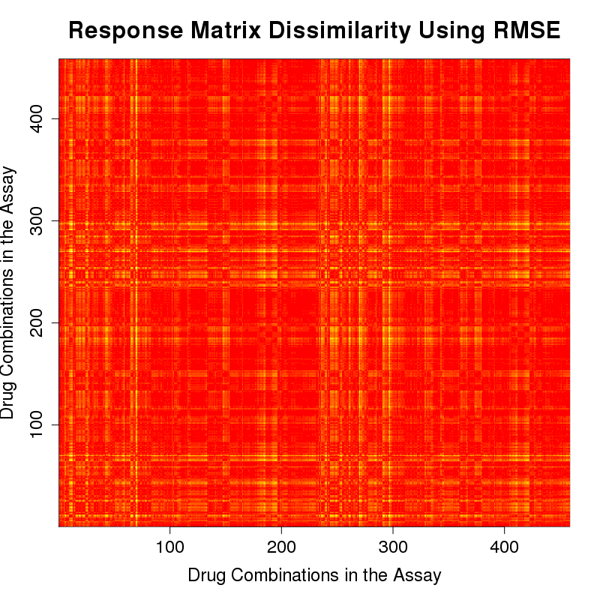
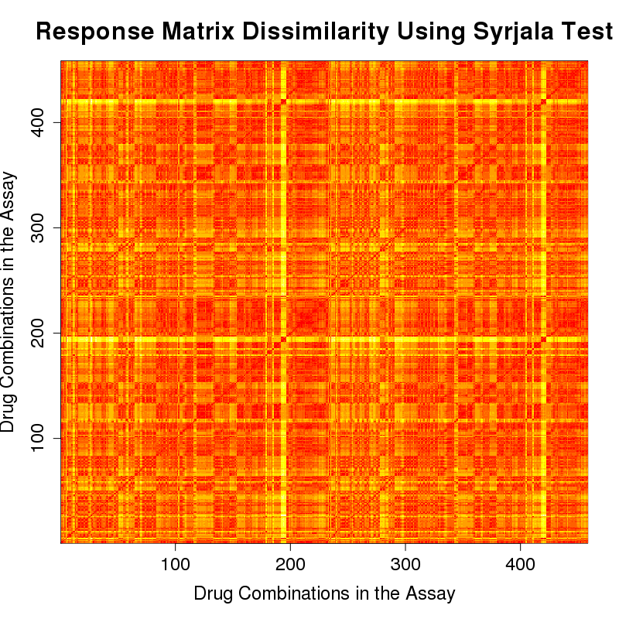
Question 1: Dissimilarity Metrics- Response Matrices Malaria Strain HB3 (AID 1764)
Red: dissimilarity=0, more similar
Yellow: dissimilarity=1,
more dissimilar
RMSE
Syrjala Test
Notes:
X and y axis- comparing one combination to another (point out diagonal line)
Red- value of dissimilarity is 0, meaning no difference between the response matrices of the two combinations
Yellow/white- value gets closer to 1, meaning very dissimilar
Note- Syrjala have more of the color variation- meaning it pulled out more differences among the response matrices
This is important when our goal is to separate out these different patterns that may exist

Slide 11
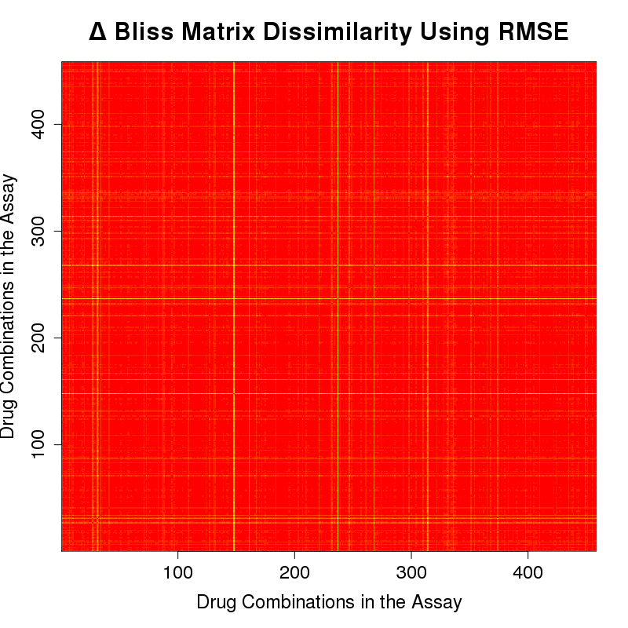
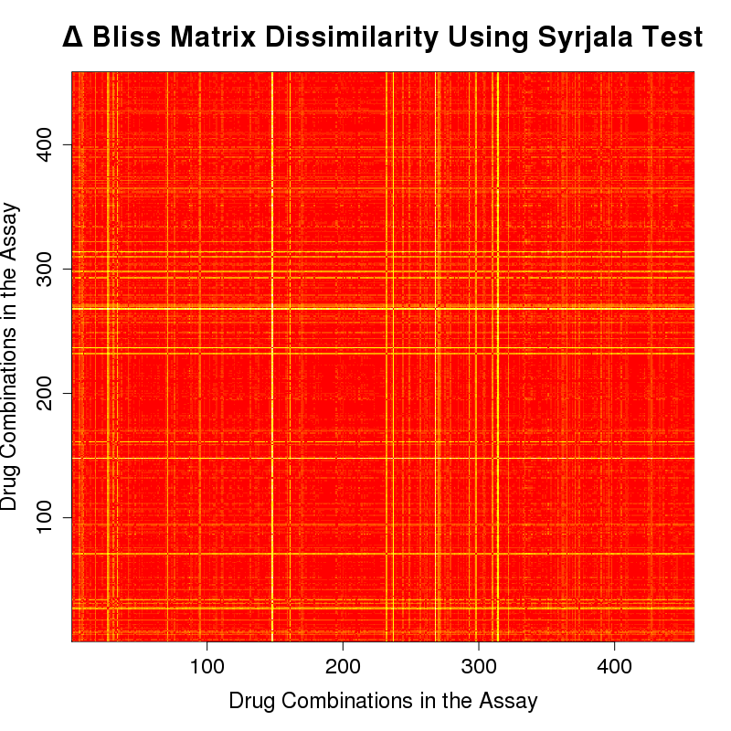
Question 1: Dissimilarity Metrics- Δ Bliss Matrices Malaria Strain HB3 (AID 1764)
Red: dissimilarity=0, more similar
Yellow: dissimilarity=1,
more dissimilar
RMSE
Syrjala Test
Notes:
Repeated for the delta bliss (synergy) surfaces

Slide 12
Overarching Questions
Question 1: What are metrics to quantify dissimilarity between two response matrices or synergy matrices?
Question 2: Does chemical structure correlate to combination response? Synergy? How?
Question 3: Does dose response correlate to combination response? Synergy? How?
Drug Combo A:
Response Matrix
Drug Combo B:
Response Matrix
Drug Combo A:
Compounds
Drug Combo B:
Compounds
Drug Combo A:
Dose Response
Drug Combo B:
Dose Response
Notes:
Question 1: found out spatial distribution is important, syrjala test
Question 2: (next slide is better)

Slide 13

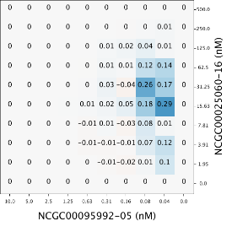
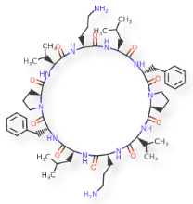
Question 2: Structure Correlated With Combination Response and Synergy
Is there a correlation between the dissimilarity of the compounds and the dissimilarity of the combination response surfaces? Δ Bliss (synergy) surfaces?
Notes:
structures of the compounds in the drug combinations,
does the dissimilarity of the chemical structures correlate to the dissimilarity of the response matrices?
D bliss matrices?
(show comparing difference of compounds, comparing to response matrices, comparing to synergy)

Slide 14
Question 2: Structure Correlated With Combination Response and Synergy- Dissimilarity of Compounds
Step 1. Compare one drug combination to another drug combination
Compare corresponding x agents
Compare corresponding y agents
Average those values
Step 2: Repeat for all pairs of combinations
x agents’ dissimilarity
y agents’ dissimilarity
Average dissimilarity

Slide 15
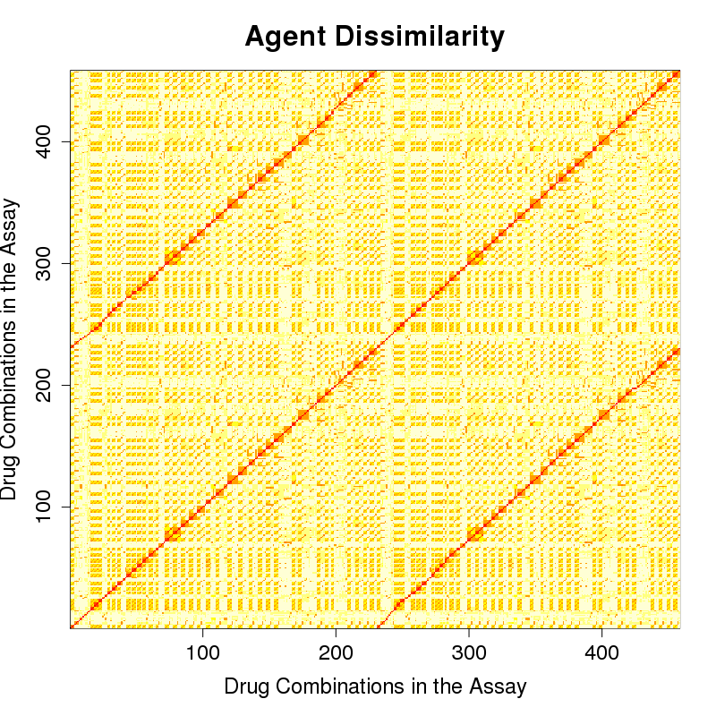
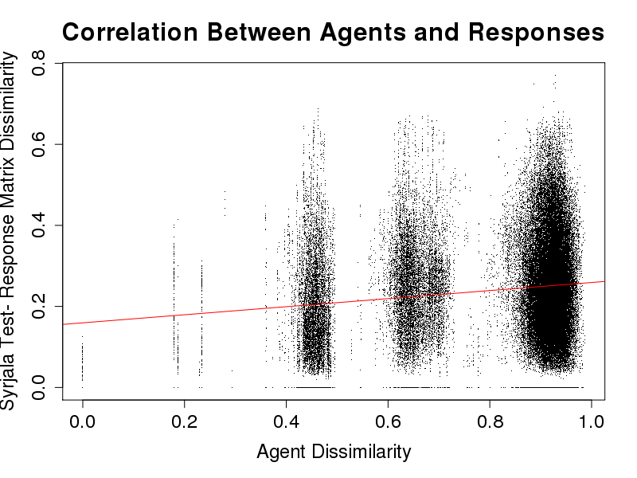
Question 2: Structure Correlated With Combination Response- Malaria Strain HB3 (AID 1764)
Agent Dissimilarities
Response Matrix Dissimilarities- Syrjala Test
R² = 0.0198
Red: dissimilarity=0, more similar
Yellow: dissimilarity=1, more dissimilar
Notes:
Scatterplot of the pairwise values of these two matrices

Slide 16
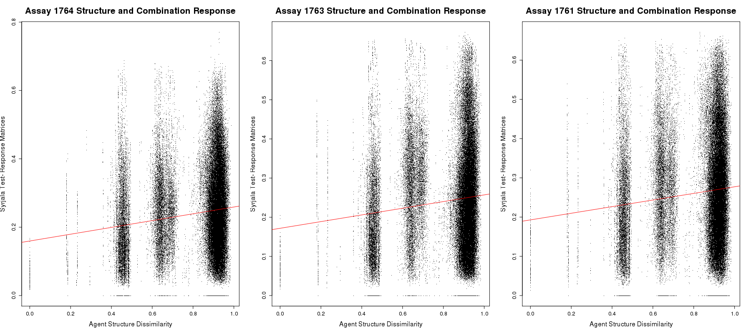
Question 2: Structure Correlated With Combination Response- Three Malaria Strains: HB3 (AID 1764), dD2 (AID 1763), 3D7 (AID 1764)

Slide 17
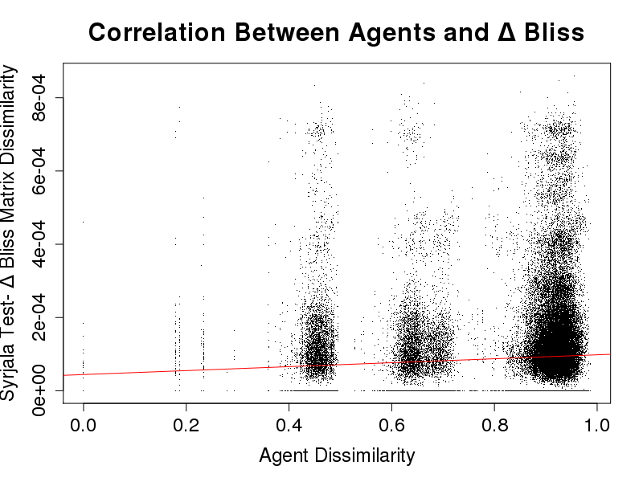
Question 2: Structure Correlated With Synergy- Malaria Strain HB3 (AID 1764)
Agent Dissimilarities
Δ Bliss (Synergy) Matrices- Syrjala Test
R² = 0.0056
Red: dissimilarity=0, more similar
Yellow: dissimilarity=1, more dissimilar

Slide 18
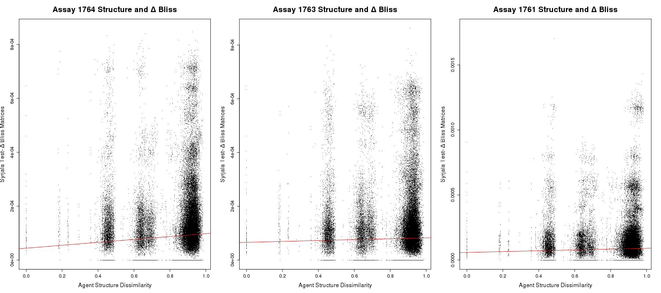
Question 2: Structure Correlated With Synergy- Three Malaria Strains: HB3 (AID 1764), dD2 (AID 1763), 3D7 (AID 1764)

Slide 19
Overarching Questions
Question 1: What are metrics to quantify dissimilarity between two response matrices or synergy matrices?
Question 2: Does chemical structure correlate to combination response? Synergy? How?
Question 3: Does dose response correlate to combination response? Synergy? How?
Drug Combo A:
Response Matrix
Drug Combo B:
Response Matrix
Drug Combo A:
Compounds
Drug Combo B:
Compounds
Drug Combo A:
Dose Response
Drug Combo B:
Dose Response

Slide 20
Question 3: Dose Response Correlated with Combination Response and Synergy
Is there a correlation between the dose responses of the compounds and the dissimilarity of the combination response surfaces? Δ Bliss (synergy) surfaces?

Slide 21
Question 3: Dose Response Correlated With Combination Response- Dissimilarity of Dose Responses
Step 1. Compare one dose response to another dose response using Lin’s CCC
Compare corresponding x agents
Compare corresponding y agents
Average those values
Step 2: Repeat for all combinations
x dose responses’ dissimilarity
y dose responses’ dissimilarity
Average dissimilarity
Lawrence I-Kuei Lin. (1989). A Concordance Correlation Coefficient to Evaluate Reproducibility. Biometrics, 45(1), 255-268.

Slide 22
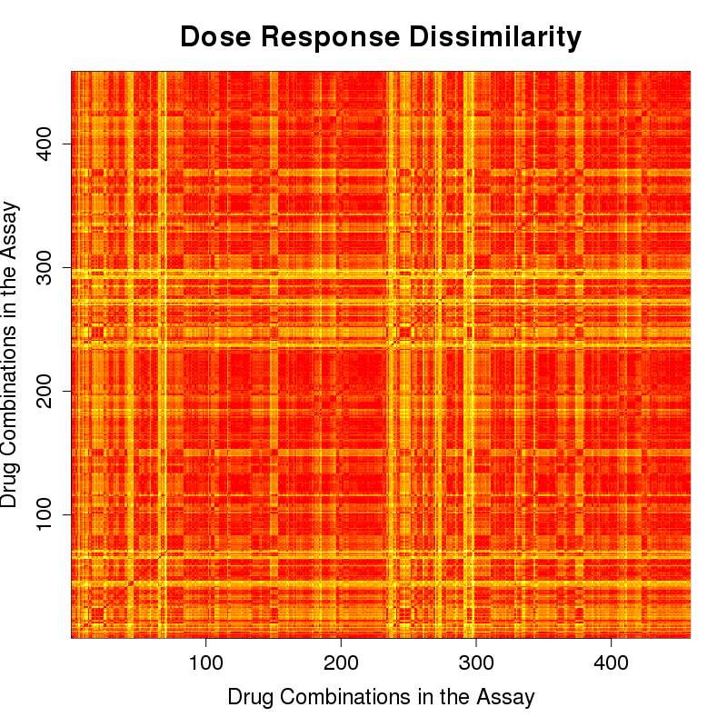
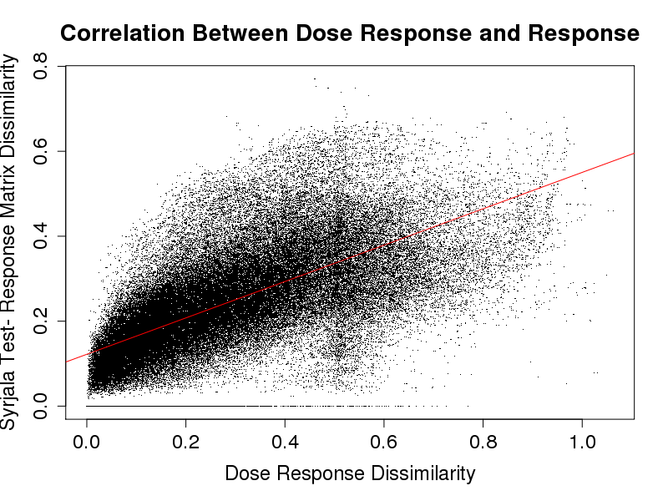
Question 3: Dose Response Correlated With Combination Response- Malaria Strain HB3 (AID 1764)
Dose Response Dissimilarities
Response Matrices- Syrjala Test
R² = 0.4365
Red: dissimilarity=0, more similar
Yellow: dissimilarity=1, more dissimilar

Slide 23
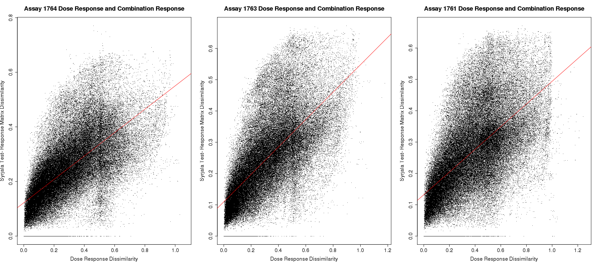
Question 3: Dose Response Correlated With Combination Response- Three Malaria Strains: HB3 (AID 1764), dD2 (AID 1763), 3D7 (AID 1764)

Slide 24
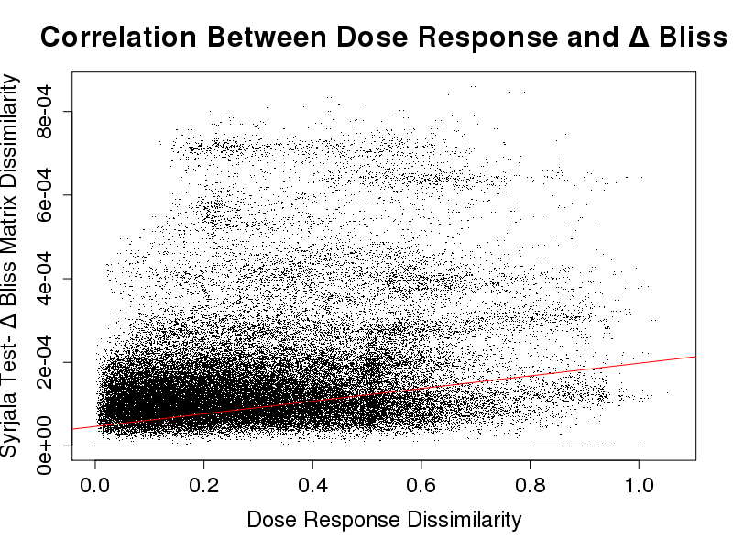
Question 3: Dose Response Correlated With Synergy- Malaria Strain HB3 (AID 1764)
Dose Response Dissimilarities
Δ Bliss (Synergy) Matrices- Syrjala Test
R² = 0.0521
Red: dissimilarity=0, more similar
Yellow: dissimilarity=1, more dissimilar

Slide 25
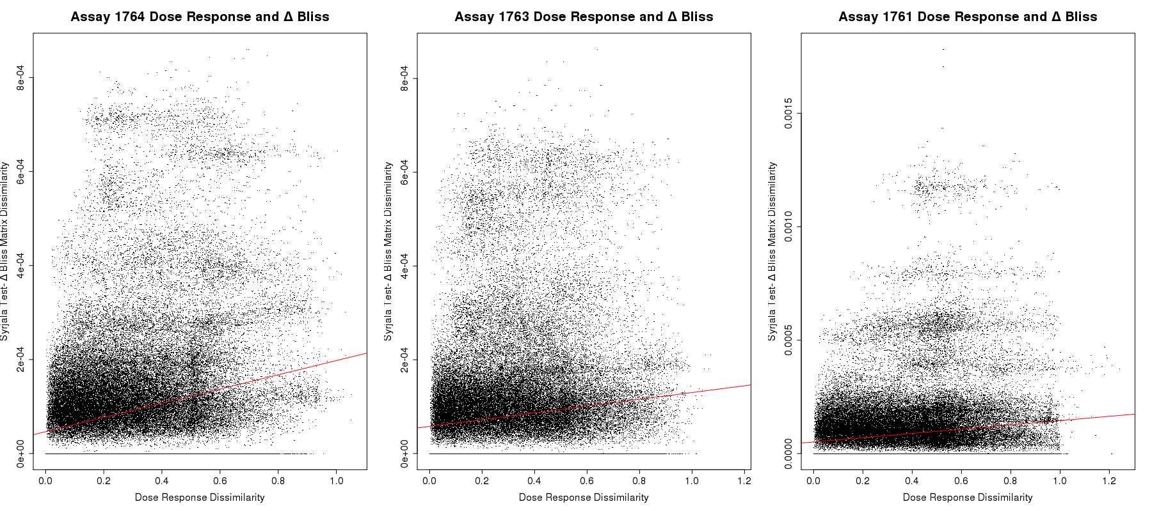
Question 3: Dose Response Correlated With Synergy- Three Malaria Strains: HB3 (AID 1764), dD2 (AID 1763), 3D7 (AID 1764)

Slide 26
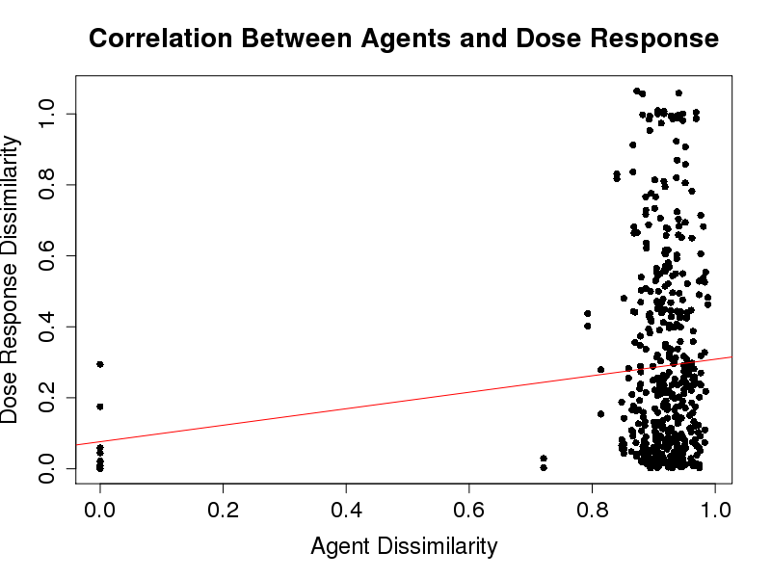
Conclusion
Individual Compounds:
We might expect structural dissimilarity to correlate with dose response dissimilarity- but they do not correlate
Suggests that using dose response as the compound property does not appear to be supported by the Similarity Property Principle (SPP)
No correlation (R² = 0.0141)
Drug Combinations:
For SPP to hold, both have to correlate- not the case
Δ Bliss plots show even weaker correlations than combination response
SPP does not appear to hold
Suggests that combination responses are not a simple function of the individual agent responses
No correlation (R² = 0.0198)
Correlation (R² = 0.4365)
Notes:
We would expect structural dissimilarity to correlate to dose response dissimilarity
Took a step back-
Reevaluated what we were using to determine if the SPP was also true for drug combinations (dissimilarity of the compounds, dose response)
Did that for this assay for comparing individual compounds to individual compounds– expected this to follow to SPP
Another limitation: maybe our ways of computing dissimilarity needed to be improved: 2 values, average into 1

Slide 27
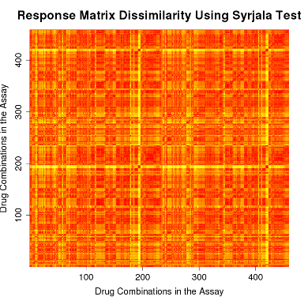
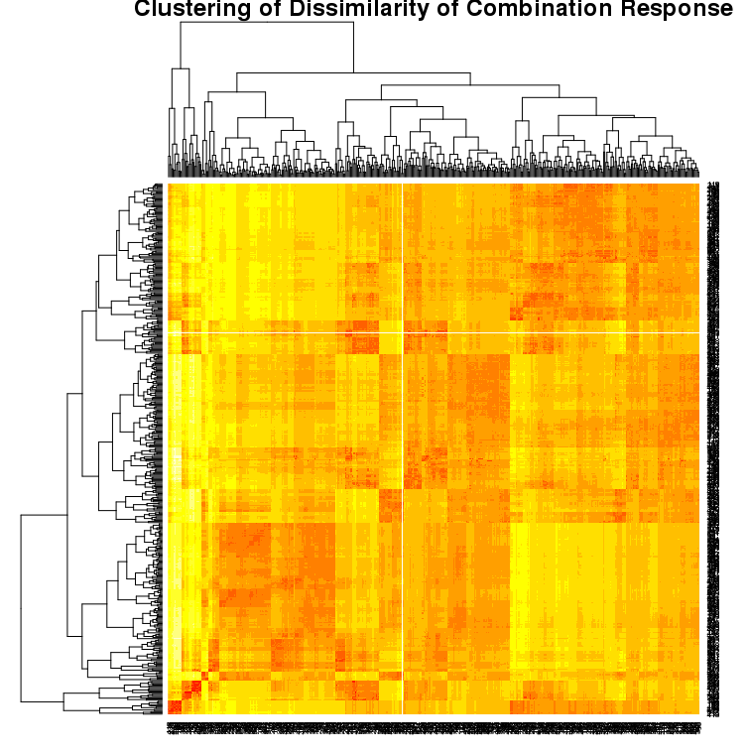
Discussion
Limitations
Dose response was not a compound property that illustrated the SPP well- use one that does
Will be able to draw better conclusions about the SPP for drug combinations using a
different compound property that is
supported by the SPP
Future Work
Clustering- work within clusters
Analysis on larger, more diverse volume of data
No correlation (R² = 0.01414)
Notes:
If we know a compound property illustrates the SPP well in individual compounds (one that does show a correlation), then we can use that for drug combinations and draw better conclusions
Different angle-
Grouping together similar response matrices (response matrices with the same pattern)- maybe within clusters the drug combinations are more similar
Lines of Malaria- three different- work with more data from more diseases
Overall-
This summer: learned about stats, coding experience will be valuable in future classes or work
Even though I’ve just talked about how much work there is to do, we’ve made progress on understanding drug combinations
I can see where being able to understand the data could means so much for clinical application
I’m excited about the work that I’m doing and have enjoyed working on this project: concludes my slides, thank you, but happy to answer any questions

